Slide 1
Lecture 17
Cloud Stack

Slide 2
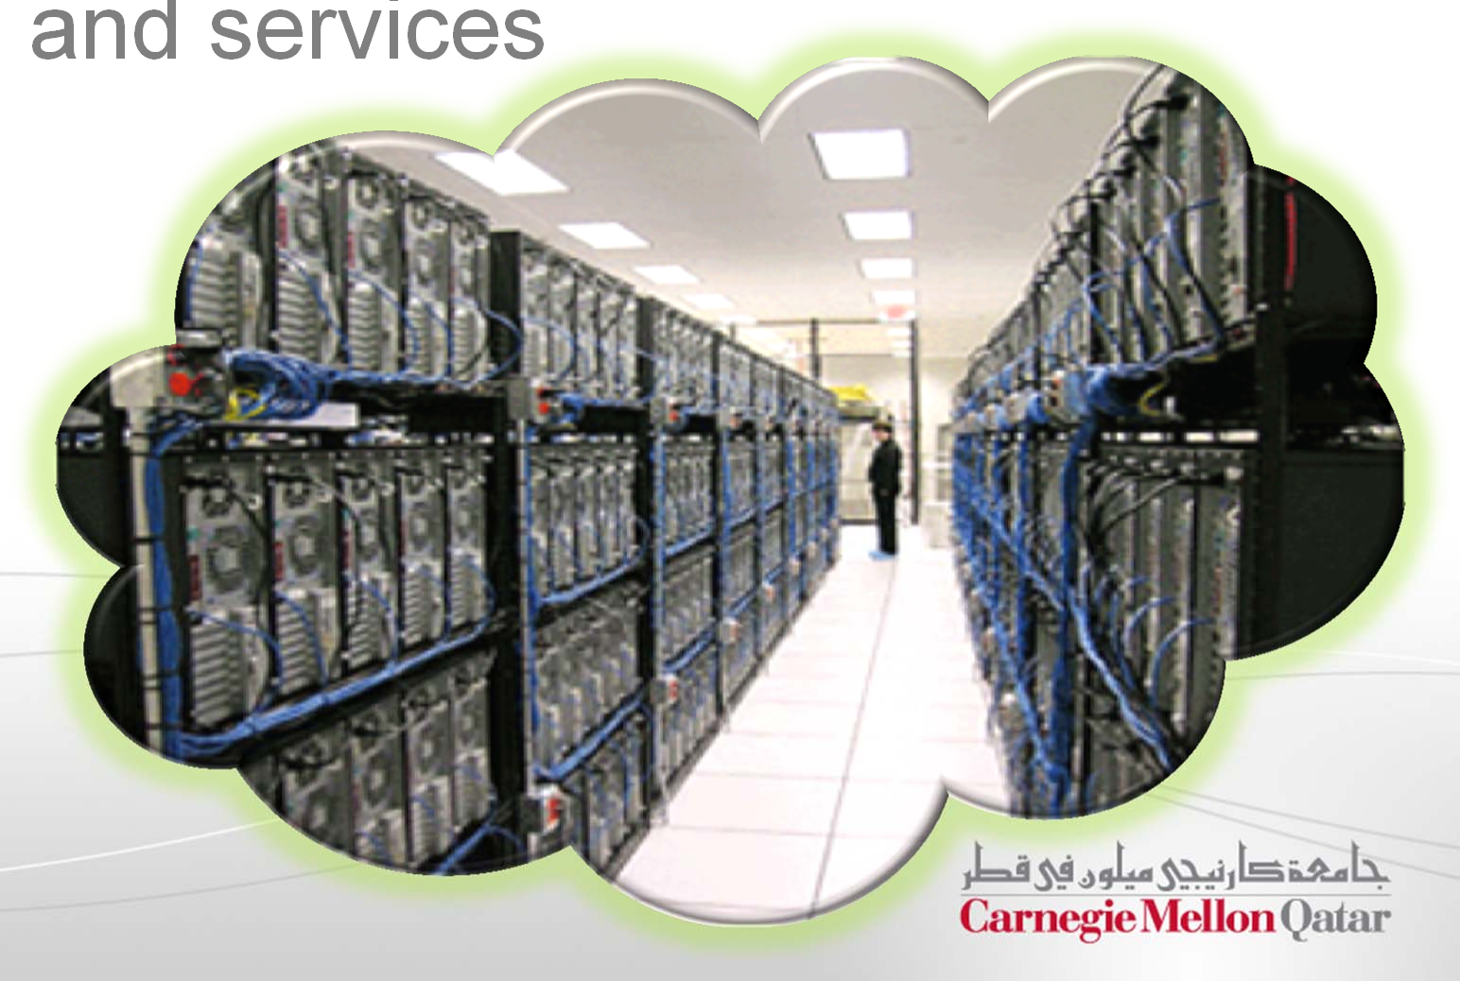
A Cloud is …
A data center hardware and software that the vendors use to offer the computing resources
and services

Slide 3
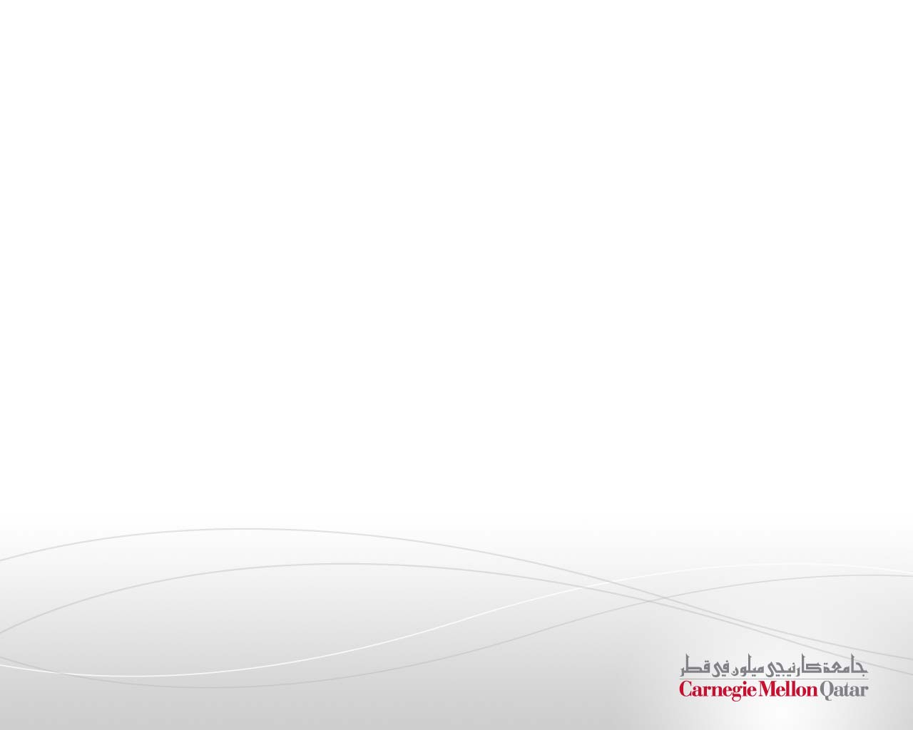

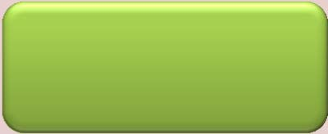
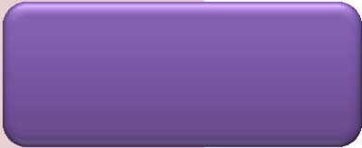
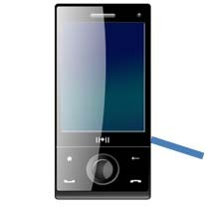
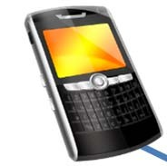
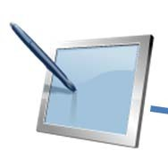
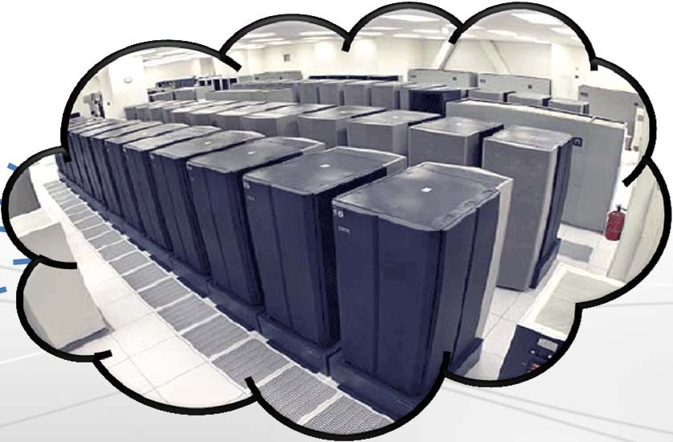
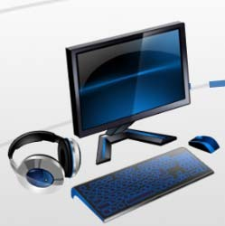
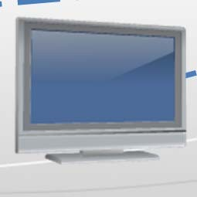
Cloud Computing
“Cloud Computing is the transformation of IT from a product to a service”
Innovation Product Service
The “Cloud”

Slide 4



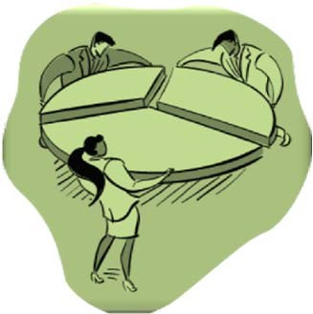
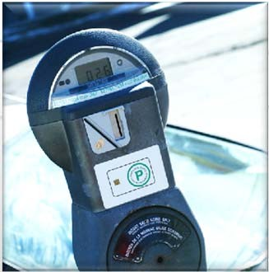
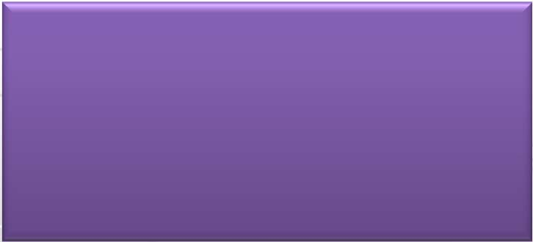
Cloud Computing
Cloud Computing is the delivery of computing as a service rather than a product,
whereby shared resources, software, and information are provided to computers and other devices,
as a metered service over a network.

Slide 5
Lecture Outline
Discussion On
Software Service Models
Types of Clouds and CMUQ’s Private Cloud
The Cloud Stack
Service Models of Cloud Computing
Cloud Infrastructure

Slide 6
IT as a Service
How do you offer IT as a service?
Different users have different needs
Consider the needs of:
Average End User
Mobile Application Developer
Enterprise System Architect
Let us look at some of the typical service models

Slide 7






Cloud Service Models
SaaS
PaaS
Software-as-a-Service
Applications running on browsers
SaaS
PaaS
Platform-as-a-Service
A software platform that is made available to developers to build cloud applications
IaaS
Infrastructure-as-a-Service
Basic computing resources such as CPU/Memory/Disk, made available to users in the form of Virtual Machine Instances
IaaS

Slide 8
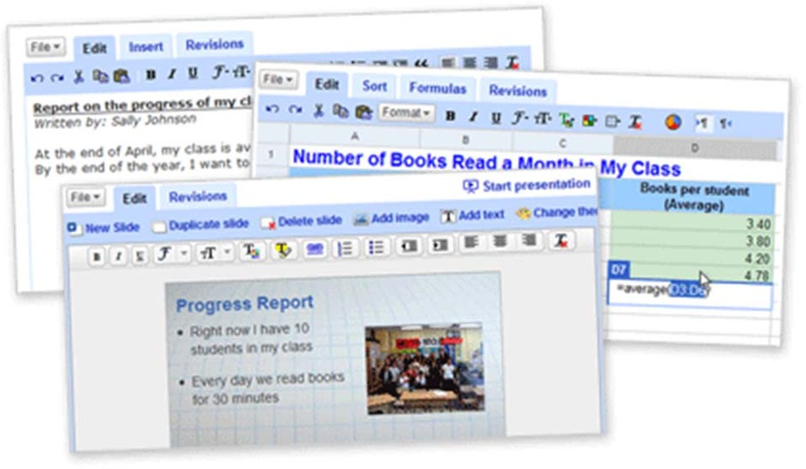
SaaS
You are most familiar with this!
SaaS
PaaS
Software is delivered as a service over the Internet, eliminating the need to install and run the application on the customer's own computer
IaaS
This simplifies maintenance and support
Examples: Gmail, YouTube, and Google Docs, among others

Slide 9
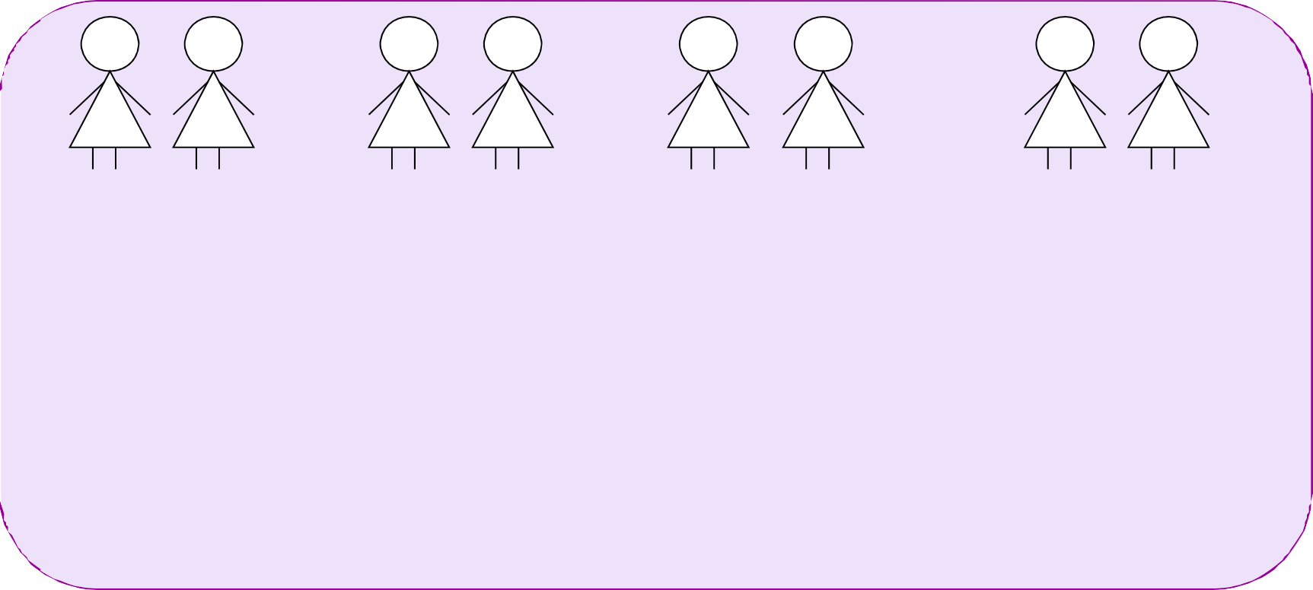

SaaS Maturity Levels
Distinguishing attributes: configurability, multi-tenant efficiency, scalability
1
2
3
4
Tenant 1
Tenant 2
Tenant 1
Tenant 2
Tenant 1 Tenant 2
Tenant 1 Tenant 2
Tenant Load Balancer
instance 1
instance 2
instance instance
Configurable
Same application but distinct instance/customer
instance
+ Multi-tenant-efficient
(+):Efficient use of server resources without apparent
differences to end users
(-): scalability limits
instance
instance
+ Scalable
Each has its own customized version of the application and run
its own instance

Slide 10
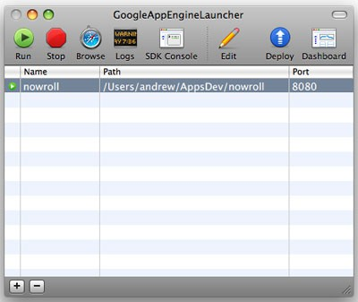
PaaS
The Cloud provider exposes a set of tools (a platform) which allows users to create SaaS applications
SaaS
PaaS
IaaS
The SaaS application runs on the provider’s infrastructure
The cloud provider manages the underlying hardware and requirements

Slide 11
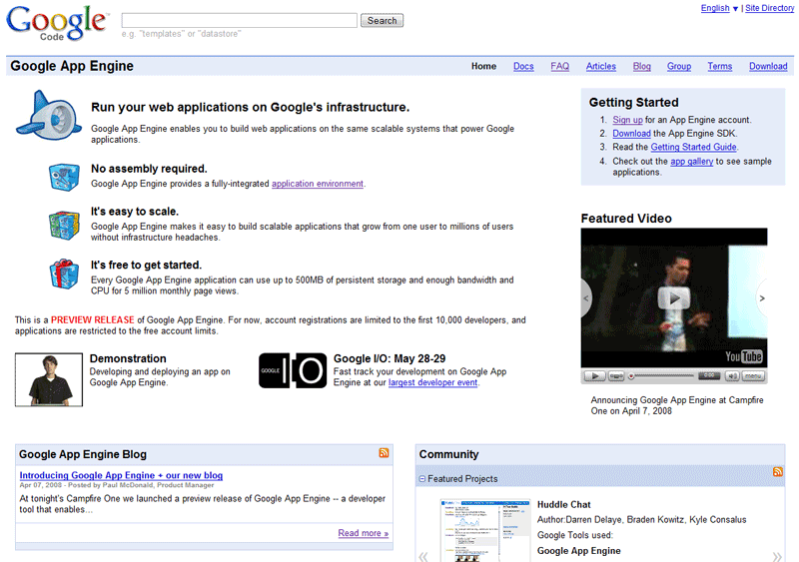
PaaS Example I
Google App Engine
Build web applications on Google’s Infrastructure

Slide 12
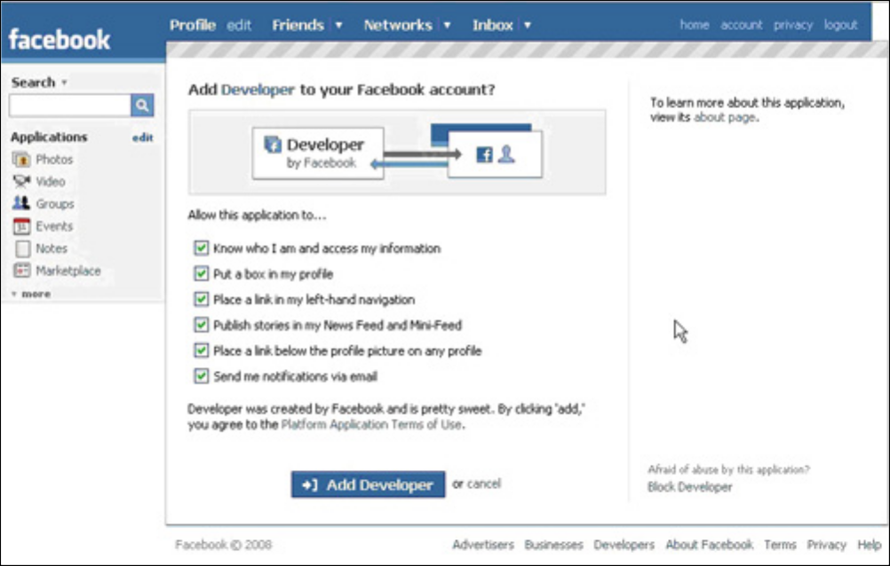
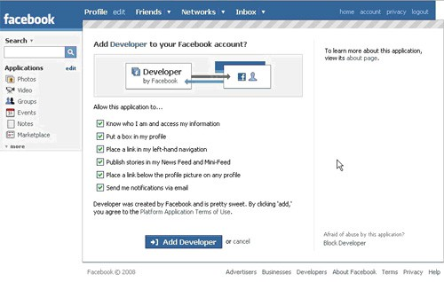
PaaS Example II
The Facebook Developer Platform
Set of APIs that allow you to create Facebook Applications

Slide 13



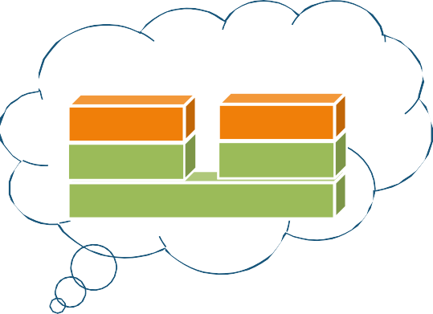



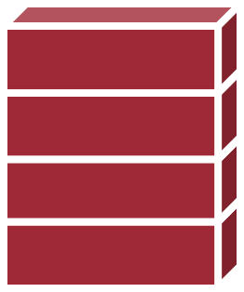
IaaS (1/3)
The cloud provider leases to users Virtual Machine Instances (i.e., computer infrastructure) using the virtualization technology
SaaS
PaaS
IaaS
The user has access to a standard Operating System environment and can install and configure all the layers above it
OS VM
OS VM
Hypervisor
Server
Server
Server Server
Cloud Provider

Slide 14

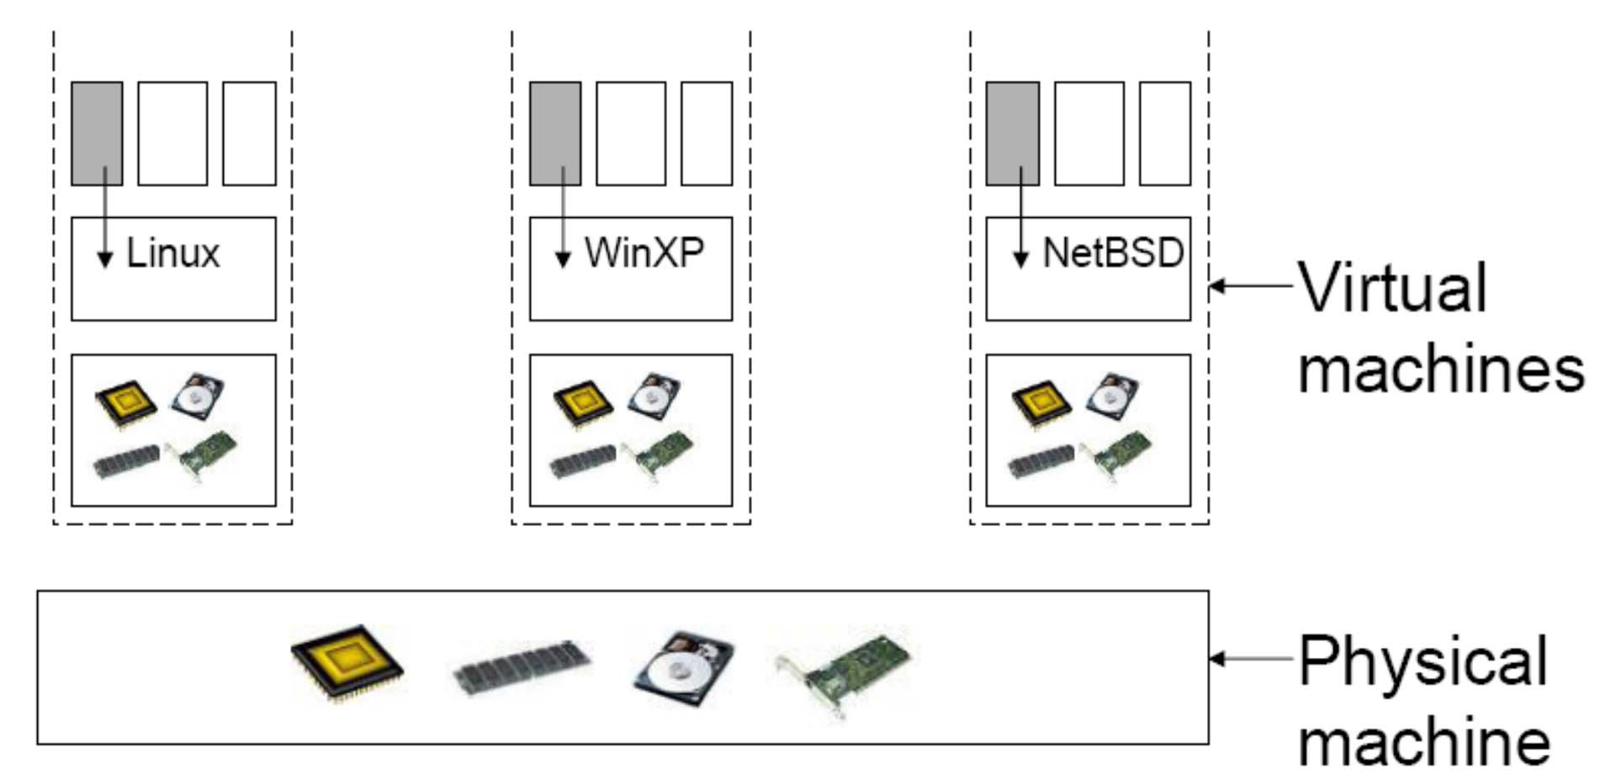



IaaS (2/3)
The virtualization technology is a major enabler of IaaS
SaaS
PaaS
IaaS
© Carnegie Mellon University in Qatar
HARDWARE
31

Slide 15
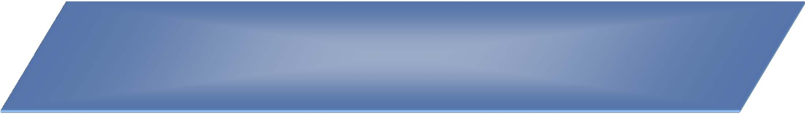






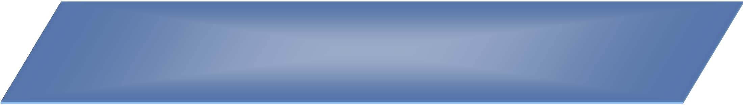





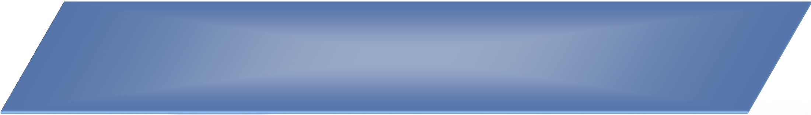
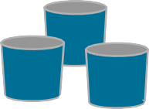
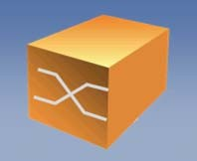


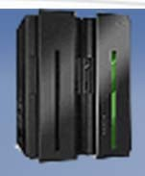
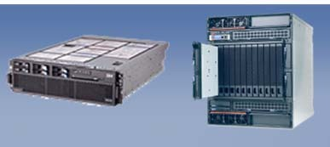
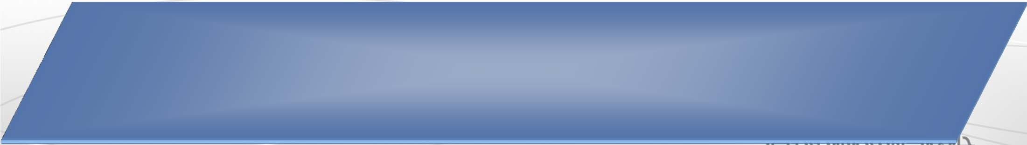

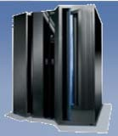

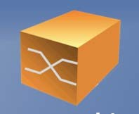

IaaS (3/3)
Service Catalog
Request UI
Operations UI
Dynamic Scheduling
Capacity Planning SLA
Monitoring
Request Driven Provisioning & Service Management
Web 2.0 Collaborative Innovation
Software Development
Virtual Classroom
Data Intensive Processing
High Volume Transactions
Workloads
Virtual Servers
Virtual Storage
Virtual Networks
Virtual Applications & Middleware
Virtual Clients
Virtualization
Servers
Power Systems
Racks, BladeCenter
Storage
Networking
Physical Layer

Slide 16
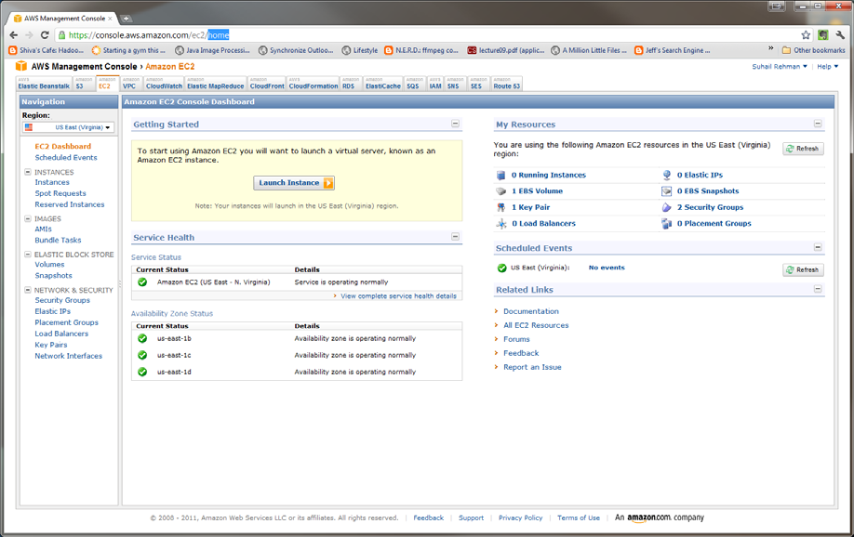
IaaS Example
Amazon Web Service Elastic Compute Cloud (EC2)

Slide 17
Other Service Models
Hardware-as-a-Service
Communication-as-a-Service
XaaS
“X” as a Service

Slide 18
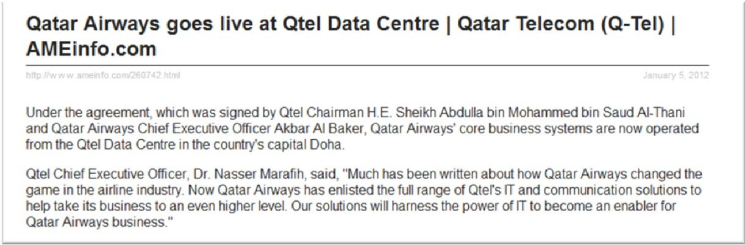
Datacenter-as-a-Service
Increasing Number of Servers
Manpower, Electricity, Cooling, Security?
Management Nightmare
Why not give it to someone else?

Slide 19
Lecture Outline
Discussion On
Software Service Models
Types of Clouds and CMUQ’s Private Cloud
The Cloud Stack
Service Models of Cloud Computing
Cloud Infrastructure

Slide 20
The Cloud Stack
Applications Data Runtime
Middleware Operating System Virtualization Servers
Storage Networking

Slide 21
Applications
Cloud applications can range from Web applications to scientific computational jobs
Applications Data Runtime Middleware
Operating System
Virtualization Servers Storage Networking

Slide 22
Data
Data Management
New generation cloud- specific databases and management systems
E.g., Hbase, Cassandra, Hive, Pig etc.
Applications Data Runtime Middleware
Operating System
Virtualization Servers Storage Networking

Slide 23
Runtime Environment
Runtime platforms to support cloud programming models
E.g., MPI, MapReduce, Pregel etc.
Applications Data Runtime Middleware
Operating System
Virtualization Servers Storage Networking

Slide 24
Middleware for Clouds
Management platforms that enable:
Resource Management
Monitoring
Provisioning
Identity Management and Security
Applications Data Runtime Middleware
Operating System
Virtualization Servers Storage Networking

Slide 25
Operating Systems
Standard Operating Systems used in Personal Computing
Packaged with libraries and software for quick deployment and provisioning
E.g., Amazon Machine Images (AMI) contain OS as well as required software packages as a “snapshot” for instant deployment
Applications Data Runtime Middleware
Operating System
Virtualization Servers Storage Networking

Slide 26
Virtualization
Key Component
Resource Virtualization
Amazon EC2 is based on the Xen virtualization platform
Applications Data Runtime Middleware
Operating System
Virtualization Servers Storage Networking

Slide 27


Cloud Service Layers in the
Service Levels
SaaS
PaaS
IaaS
Packaged Software
IaaS
PaaS
SaaS
Applications Data Runtime Middleware
Operating System Virtualization
Servers Storage
Networking
User Managed
Applications Data Runtime Middleware
Operating System
Virtualization Servers Storage Networking
Applications Data Runtime Middleware
Operating System
Virtualization Servers Storage Networking
Applications Data Runtime Middleware
Operating System
Virtualization Servers Storage Networking
User Managed
User Managed
Vendor Managed
Vendor Managed
Vendor Managed

Slide 28
Lecture Outline
Discussion On
Software Service Models
Types of Clouds and CMUQ’s Private Cloud
The Cloud Stack
Service Models of Cloud Computing
Cloud Infrastructure

Slide 29
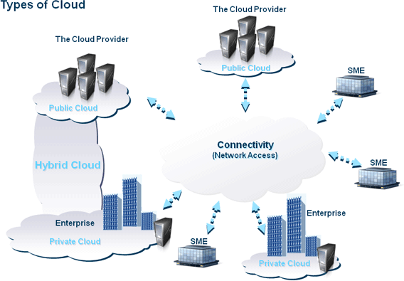
Types of Clouds (1/4)
Public
Private
Hybrid

Slide 30
Types of Clouds (2/4)
Public (external) cloud
Open market for on demand computing and IT resources
Concerns: Limited SLA, reliability, availability, security, trust and confidence
Examples: IBM, Google, Amazon, …

Slide 31
Types of Clouds (3/4)
Private (Internal) cloud
For enterprises/corporations with large scale IT

Slide 32
Types of Clouds (4/4)
Hybrid cloud
Extend the private cloud(s) by connecting it to other external cloud vendors to make use of their available cloud services
Cloud Burst
Use the local cloud, and when you need more resources, burst into the public cloud

Slide 33
The Qloud: CMUQ’s Private Cloud

Slide 34
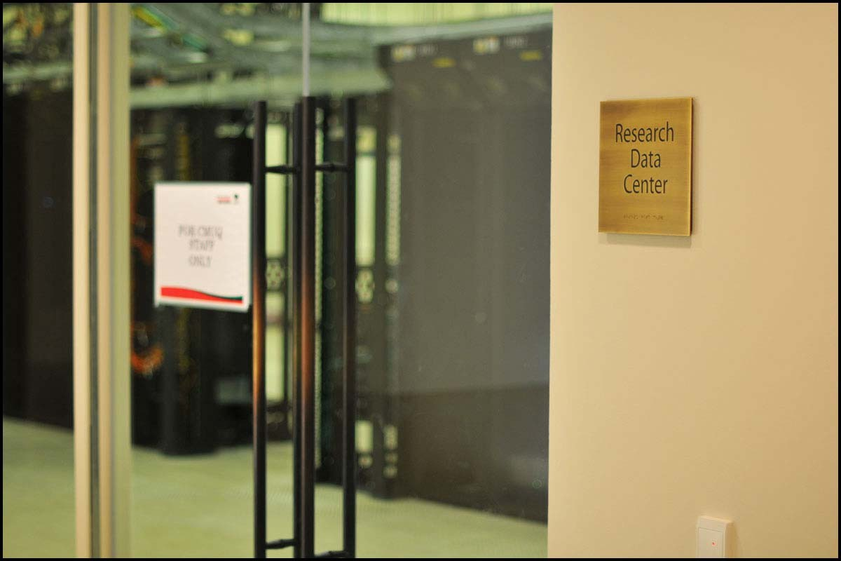
CMU-Q’s Research Data Center

Slide 35
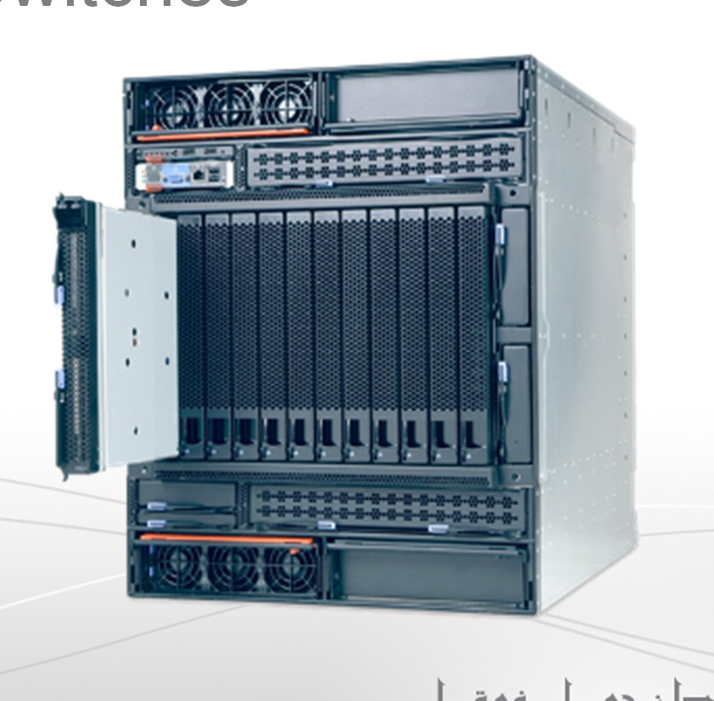
One of Qloud Hardware (1/3)
IBM Bladecenter H
Advanced Management Module
Two Nortel Gigabit Switches
112 cores
7TB of storage
14 Blades

Slide 36
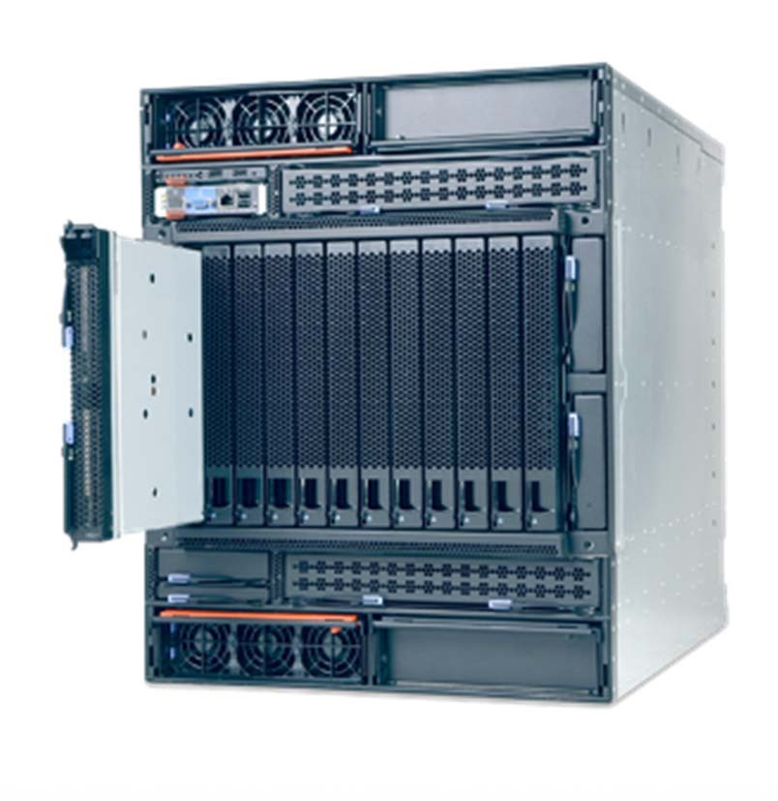
One of Qloud Hardware (2/3)
Each Blade
Intel Xeon(R) Intel Xeon(R) CPU (8-core) CPU (8-core)
3.16GHz & 64-bit 3.16GHz & 64-bit
Bandwidth: 21.3GB/s
8 GB RAM
speed is 667MHz
Bandwidth: 600MB/s
300 GB SAS
SCS 1 disk
300 GB SAS
SCS 1 disk

Slide 37
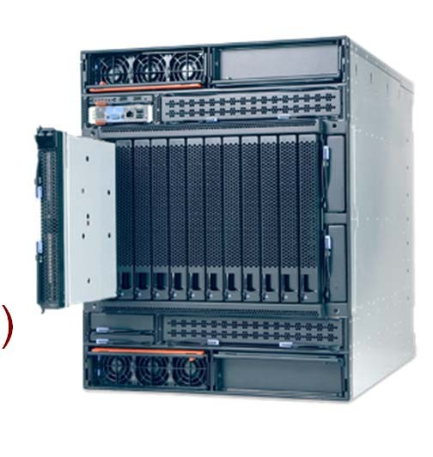
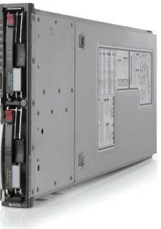
One of Qloud Hardware (3/3)
Qloud Network
2 1-Gbit switches
Each blade is connected to each of the switches
13 VM hosts Blade #14 (Contro
l)
…
…
…
.
1 Gbit switch
1 Gbit switch

Slide 38

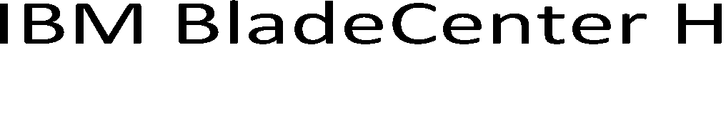

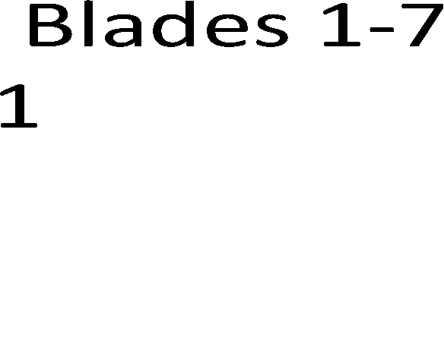
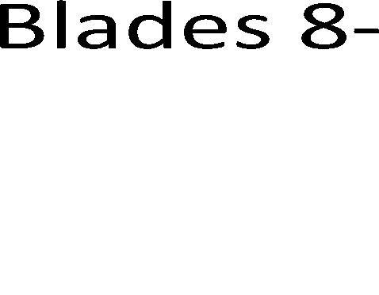

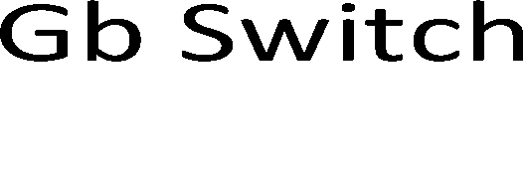




















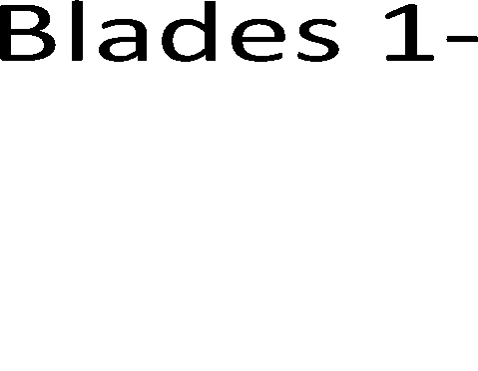









Qloud Stack
Applications Data Runtime
Middleware Operating System Virtualization Servers
Storage Networking

Slide 39
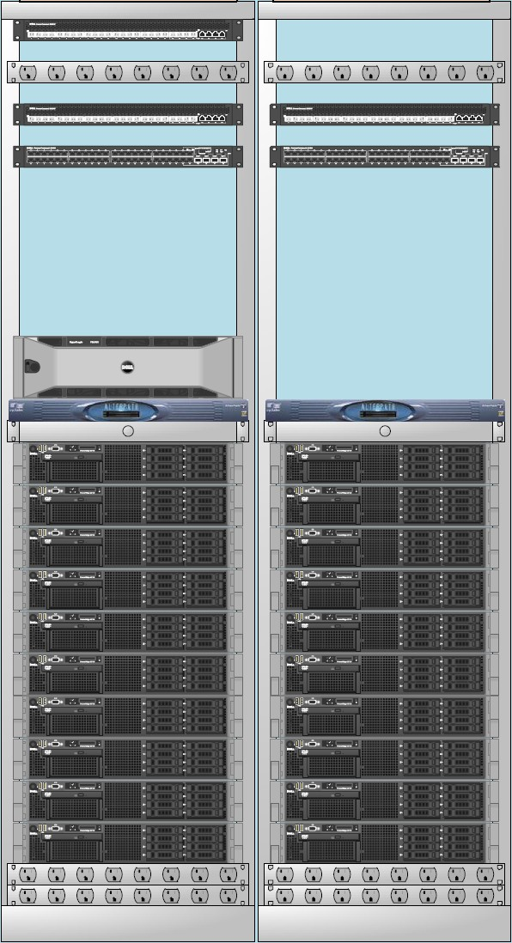


A New Cloud at CMU-Q
Total Installed Capacity:
20 Servers
240 Cores, 960 GB Memory,
18 TB local storage, 20 TB SAN Storage
VMWare vSphere 4.x Virtualization Environment

Slide 40
Lecture Outline
Discussion On
Software Service Models
Types of Clouds and CMUQ’s Private Cloud
The Cloud Stack
Service Models of Cloud Computing
Cloud Infrastructure

Slide 41
Economics of Cloud Computing
Evolution of Software Service Models
What is the Value Proposition for Cloud Computing?
How did Cloud Computing emerge from business / industry rather than from Academia?

Slide 42
Cost of Information Technology
When you are using IT there are three primary costs associated with it:
Software Cost (Media + License cost/user)
Support Cost (Vendor Support, Updates and Patches etc.)
Management Cost (IT Infrastructure costs, Manpower, etc.)

Slide 43
Traditional Model
Classical Model
Software provider develops software and charges a license fee per user for the client
The provider may charge a support fee /user
The management of the software is the clients responsibility
Up to 4x the cost of the actual software per year!
Infrastructure, Manpower, software maintenance
Traditional Software – Oracle etc.

Slide 44
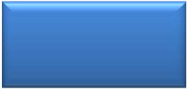

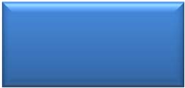


Software Service Models
Traditional
Software Cost
$4000 /user (one-time)
Support Cost
$800 /user
/year
Up to 4x the cost of Software!
Management Cost
Deployment Location
Client Side

Slide 45
Open Source Model
“Free” Model
Software provider packages Open Source Software and provides it at little or no cost to the client
The provider makes money on support – charges a higher fee than traditional model
The cost of Managing the software remains the same as Traditional Model
Up to 4x the cost of the actual software per year!
Infrastructure, Manpower, software maintenance

Slide 46





Software Service Models
Traditional
Open Source
Software Cost
$4000 /user (one-time)
$0 /user
Support Cost
$800 /user
/year
$1600 /user
/year
Management Cost
Up to 4x the cost of Software!
Deployment Location
Client Side

Slide 47
Outsourcing Model
Primary cost of Software Management is in Manpower
Why not delegate the management of software to a country with cheaper labor costs
India, China etc.
Outsource the management of software for a flat fee – keep IT management costs under control

Slide 48
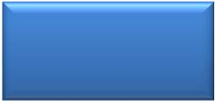
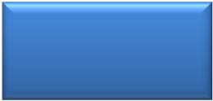



Software Service Models
Traditional
Open Source
Outsourcing
Software Cost
$4000 /user (one-time)
$0 /user
$4000 /user (one-time)
Support Cost
$800 /user
/year
$1600 /user
/year
$800 /user
/year
Up to 4x the cost of Software!
< 1300 /user
/month
Management Cost
Deployment Location
Client Side
Client or Provider Side

Slide 49
Hybrid and Hybrid+ Model
Business Software Requirements do not change often.
ERP/Financials/CRM etc.
Why reinvent the wheel?
Standardize, Specialize and Repeat
Create a flexible version of the Software that can be quickly configured and deployed.
Automate support through remote access.
Sell easy to deploy software to many clients.
Decrease the Margin
Increase the Customers
Hybrid+ is more advanced – charge a flat monthly fee for the software, support and management

Slide 50







Software Service Models
Traditional
Open Source
Outsourcing
Hybrid
Hybrid+
Software Cost
$4000 /user (one-time)
$0 /user
$4000 /user (one-time)
$4000 /user (one-time)
Support Cost
$800 /user
/year
$1600 /user
/year
$800 /user
/year
$800 /user
/year
$300 / user month
Up to 4x the cost of Software!
Bid < 1300
/user /month
$150 /user
/month
Management Cost
Deployment Location
Client Side
Client or Provider Side

Slide 51
Software as a Service Cloud Computing
Develop Web Application
Offer to customers over Internet
No deployment costs
Amortize Management and Support costs over many clients

Slide 52


Software Service Models
Traditional
Open Source
Outsourcing
Hybrid
Hybrid+
SaaS
Software Cost
$4000 /user (one-time)
$0 /user
$4000 /user (one-time)
$4000 /user (one-time)
Support Cost
$800 /user
/year
$1600 /user
/year
$800 /user
/year
$800 /user
/year
$300 / user month
< $100 /user
/month
Up to 4x the cost of Software!
Bid < 1300
/user /month
$150 /user
/month
Management Cost
Deployment Location
Client Side
Client or Provider Side
Provider Side

